Slide 1
CS211 Computer Architecture Lecture 33: Pipeline Datapath- Data Hazard
Ravi Mittal
ravi.mittal@iitgoa.ac.in
Indian Institute of Technology, Goa

Slide 2
Acknowledgements
Class Presentation, RISC-V CPU Control, Pipelining, CS61C, Great Ideas in Computer Architecture, University of Berkeley, Morgan Rae Rechenberg
Book: Digital Design and Computer Architecture: RISC-V Edition, Harris & Harris Elsevier
Class Presentation, CS61C, Machine Structures, University of Berkeley, Dan Garcia and Miki Lustig, 2019
Class Presentation, CS61C, Introduction to Assembly Language and RISC-V Instruction Set Architecture, University of Berkeley, Prof Krste Asanović & Randy H. Katz. http://inst.eecs.Berkeley.edu/~cs61c
Computer Organization and Design, The Hardware Software Interface, RISC-V edition, Patterson and Hennessey

Slide 3
Last Class

Slide 4
Pipelining Hazards
A hazard is a situation that prevents starting the next instruction in the next clock cycle
Structural hazard (Resource Dependence)
A required resource is busy (e.g. needed in multiple stages)
Data hazard (Data Dependence)
Data dependency between instructions
Need to wait for previous instruction to complete its data read/write
Control hazard
Flow of execution depends on previous instruction

Slide 5

Structural Hazard: Regfile!
RegFile: Used in ID and WB!
Time (clock cycles)
I
n
s
t
r
O
r
d
e
r
Load
Add
Store
Sub
Or

Slide 6
Regfile Structural Hazards
Each instruction:
can read up to two operands in decode stage
can write one value in writeback stage
Avoid structural hazard by having separate “ports”
two independent read ports and one independent write port
Three accesses per cycle can happen simultaneously
RW
RA
RB
Write Enable
5
5
5
portA
portW
32 x 32-bit
Registers
32
32
portB
Clk
32
Ref: CS61C Morgan Reschenberg, Univ of California, Berkeley

Slide 7
Instruction and Data Caches
Processor
Memory (DRAM)
Control
Instruction Cache
Program
Datapath
PC
Bytes
Data
Cache
Registers
Arithmetic & Logic Unit
(ALU)
Data
Caches: small and fast “buffer” memories
Ref: CS61C Morgan Reschenberg, Univ of California, Berkeley

Slide 8
Structural Hazards – Summary
Conflict for use of a resource
In RISC-V pipeline with a single memory
Load/store requires data access
Without separate memories, instruction fetch would have to stall for that cycle
All other operations in pipeline would have to wait
Pipelined datapaths require separate instruction/data memories
Or separate instruction/data caches
RISC-V is designed to avoid structural hazards
e.g. at most one memory access/instruction
Ref: CS61C Morgan Reschenberg, Univ of California, Berkeley

Slide 9
In this class we will study
Data Hazard in R-type Instructions
Data Hazard Solutions: Nop, Forwarding
Data Hazard in Loads
Data Hazard Solutions: Stalling Pipeline, Rearranging instructions

Slide 10
Data Hazard in R-type Instructions

Slide 11
Data Hazards
Consider the following sequence of instructions:
add t0, t1, t2
sub t4, t0, t3
and t5, t0, t6
or t7, t0, t8
xor t9, t0, t10
Stored
during WB
Read during ID
Ref: CS61C Morgan Reschenberg, Univ of California, Berkeley

Slide 12
Data Hazards
Identifying data hazards:
Where is data WRITTEN?
Where is data READ?
Does the WRITE happen AFTER the READ?
Time (clock cycles)
Only an issue if no double pumping – Write during the first half and read during the second half
add t0, t1, t2
sub t4, t0, t3
and t5, t0, t6
or t7, t0, t8
xor t9, t0, t10
Ref: CS61C Morgan Reschenberg, Univ of California, Berkeley

Slide 13
Data Hazards
Without some fix, sub and and will calculate wrong result!
Time (clock cycles)
Only an issue if no double pumping – Write during the first half and read during the second half
add t0, t1, t2
sub t4, t0, t3
and t5, t0, t6
or t7, t0, t8
xor t9, t0, t10
Ref: CS61C Morgan Reschenberg, Univ of California, Berkeley

Slide 14
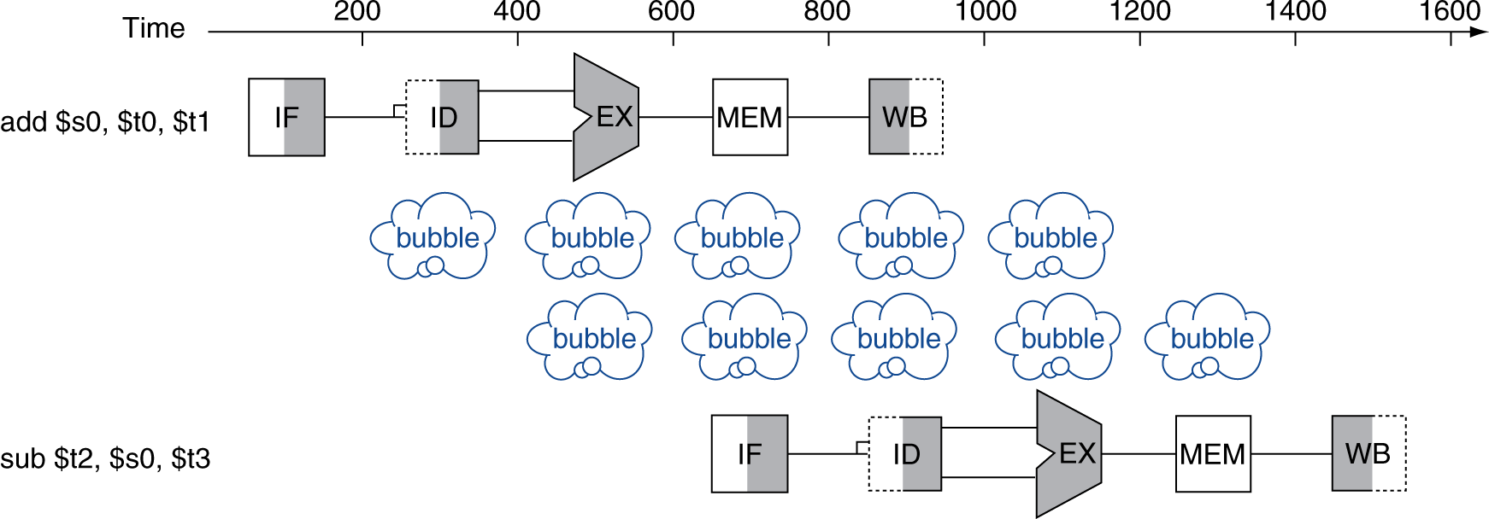


Solution 1: Stalling
Problem: Instruction depends on result from previous instruction
add t0, t1, t2 sub t4, t0, t3
Bubble:
effectively NOP: affected pipeline stages do “nothing” (add x0 x0 x0)
Insert NOP at compile time → compilers need to know about pipeline
Ref: CS61C Morgan Reschenberg, Univ of California, Berkeley

Slide 15
Nops and Performance
A software solution would be to require the programmer or compiler to insert nop instructions between instructions
The software interlocks, nops, complicates programming and degrades performance
Not an ideal solution

Slide 16
Data Hazard Solution 2: Forwarding
Forward result as soon as it is available, even though it’s not stored in RegFile yet
add t0, t1, t2
sub t4, t0, t3
and t5, t0, t6
or t7, t0, t8
xor t9, t0, t10
Forwarding: grab operand from pipeline stage, rather than register file
Ref: CS61C Morgan Reschenberg, Univ of California, Berkeley

Slide 17
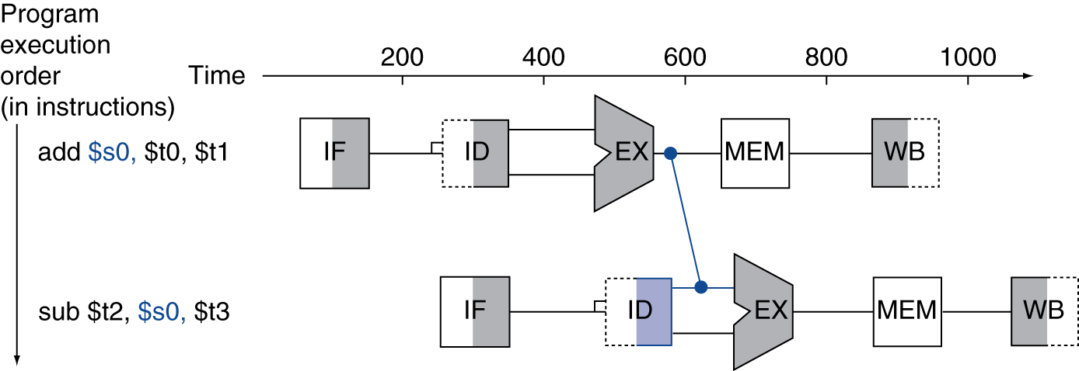
Forwarding (aka Bypassing)
Use result when it is computed
Don’t wait for it to be stored in a register
Requires extra hardware in the datapath (and extra control!)
Ref: CS61C Morgan Reschenberg, Univ of California, Berkeley

Slide 18
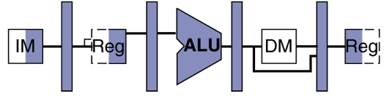
Detect Need for Forwarding (example)
Compare destination of older instructions in pipeline with sources of new instruction in decode stage.
Must ignore writes to x0
D
X
M
W
inst_{X}.rd
add t0, t1, t2
inst_{D}.rs1
or t3, t0, t5
sub t6, t0, t3
Ref: CS61C Morgan Reschenberg, Univ of California, Berkeley

Slide 19
Forwarding Path
pc_{X}
pc_{M}
pc_{F}
pc_{D}
+4
+4
Reg[]
rs1_{X}
1
DataD
ALU
DMEM
alu_{X}
0
AddrD
Branch Comp.
alu_{M}
Addr
DataR
pc_{F}+4
IMEM
AddrA
DataA
DataW
AddrB
DataB
inst_{D}
rs2_{X}
rs2_{M}
Imm.
imm_{X}
inst_{X}
inst_{M}
inst_{W}
Forwarding Control Logic
Ref: CS61C Morgan Reschenberg, Univ of California, Berkeley

Slide 20
Data Hazard in Loads

Slide 21

Data Hazard: Loads
Recall: Dataflow backwards in time are hazards
Can’t solve all cases with forwarding
Must stall instruction dependent on load (sub), then forward after the load is done (more hardware)
lw t0, 0(t1)
sub t3, t0, t2
Ref: CS61C Morgan Reschenberg, Univ of California, Berkeley

Slide 22
Data Hazard: Loads – Sol 1: Stalling
Hardware stalls pipeline
Called “hardware interlock”
Holding up the operation until data is available
This is what happens in hardware in a “hardware interlock”
lw t0, 0(t1)
sub t3, t0, t2
bubble
and t5, t0, t4
bubble
bubble
or t7, t0, t6
Ref: CS61C Morgan Reschenberg, Univ of California, Berkeley

Slide 23
Data Hazard: Loads
Stalling the sub instruction after Decoding operation (before register read). Instruction add should remain in Fetch stage during both cycles.. And so on
Use forwarding
lw t0, 0(t1)
sub t3, t0, t2
bubble
Double pumping
and t5, t0, t4
bubble
bubble
or t7, t0, t6
Ref: CS61C Morgan Reschenberg, Univ of California, Berkeley

Slide 24
Stalling Hardware
Book: Harris and Harris

Slide 25
Stalling – Another example (self reading)
Book: Harris and Harris

Slide 26
Stalling – Another example (self reading)
Book: Harris and Harris

Slide 27
Data Hazard Loads: Soln 2 Rearrange Instructions
Move independent useful instructions forward
If there are instructions that are not data dependent on the current instruction, these can be moved up next to the current instruction
This will insure that there is no stalls
The number of independent instructions to be inserted (moved up) depends on when the data is becoming available (due to dependency)
Care must be taken in moving instruction forward (moving up).
Ref: CS61C Morgan Reschenberg, Univ of California, Berkeley

Slide 28
Code Scheduling to Avoid Stalls
Reorder code to avoid use of load result in the next instruction!
RISC-V code for D=A+B; E=A+C;
13 cycles
11 cycles
Original Order:
lw t1, 0(t0)
lw t2, 4(t0)
add t3, t1, t2
sw t3, 12(t0)
lw t4, 8(t0)
add t5, t1, t4
sw t5, 16(t0)
Alternative:
lw t1, 0(t0)
lw t2, 4(t0)
lw t4, 8(t0)
add t3, t1, t2
sw t3, 12(t0)
add t5, t1, t4
sw t5, 16(t0)
Stall!
Stall!
Uses forwarding also
Ref: CS61C Morgan Reschenberg, Univ of California, Berkeley

Slide 29
Quiz 1
For the code sequences below, choose one of the statements below:
addi $t1,$t0,1
addi $t2,$t0,2
addi $t3,$t0,2
addi $t3,$t0,4
addi $t5,$t1,5
No stalls as is
No stalls with forwarding
Must Stall
Ref: CS61C Morgan Reschenberg, Univ of California, Berkeley

Slide 30
Quiz 1
For the code sequences below, choose one of the statements below:
addi $t1,$t0,1
addi $t2,$t0,2
addi $t3,$t0,2
addi $t3,$t0,4
addi $t5,$t1,5
No stalls as is
No stalls with forwarding
Must Stall
Ref: CS61C Morgan Reschenberg, Univ of California, Berkeley

Slide 31
Quiz 2
For the code sequences below, choose one of the statements below:
add $t1,$t0,$t0
addi $t2,$t0,5
addi $t4,$t1,5
No stalls as is
No stalls with forwarding
Must Stall
Ref: CS61C Morgan Reschenberg, Univ of California, Berkeley

Slide 32
Quiz 2
For the code sequences below, choose one of the statements below:
add $t1,$t0,$t0
addi $t2,$t0,5
addi $t4,$t1,5
No stalls as is
No stalls with forwarding
Must Stall
Ref: CS61C Morgan Reschenberg, Univ of California, Berkeley

Slide 33
Quiz 3
For the code sequences below, choose one of the statements below:
lw $t0,0($t0)
add $t1,$t0,$t0
No stalls as is
No stalls with forwarding
Must Stall
Ref: CS61C Morgan Reschenberg, Univ of California, Berkeley

Slide 34
Quiz 3
For the code sequences below, choose one of the statements below:
lw $t0,0($t0)
add $t1,$t0,$t0
No stalls as is
No stalls with forwarding
Must Stall
Ref: CS61C Morgan Reschenberg, Univ of California, Berkeley

Slide 35
Class Summary
Hazards potentially limit performance
Data Hazard are due to data dependency
There are multiple ways to handle data dependency
Insert NOPS – Software driven – complicated
Data Forwarding
Stall the pipeline – when data dependency can’t be resolved by compiler and other methods – Hardware driven
Rearrange Instructions (forward independent instructions – that have no data dependency) – Compiler driven

